Slide 1

A Quantitative Discourse Analysis of Asian Workers in the US Historical Newspapers
Jaihyun Park, Ryan Cordell
{jaihyun2, rcordell}@illinois.edu
School of Information Sciences
University of Illinois at Urbana-Champaign
NLP4DH-IWCUL 2023
Tokyo, Japan

Slide 2
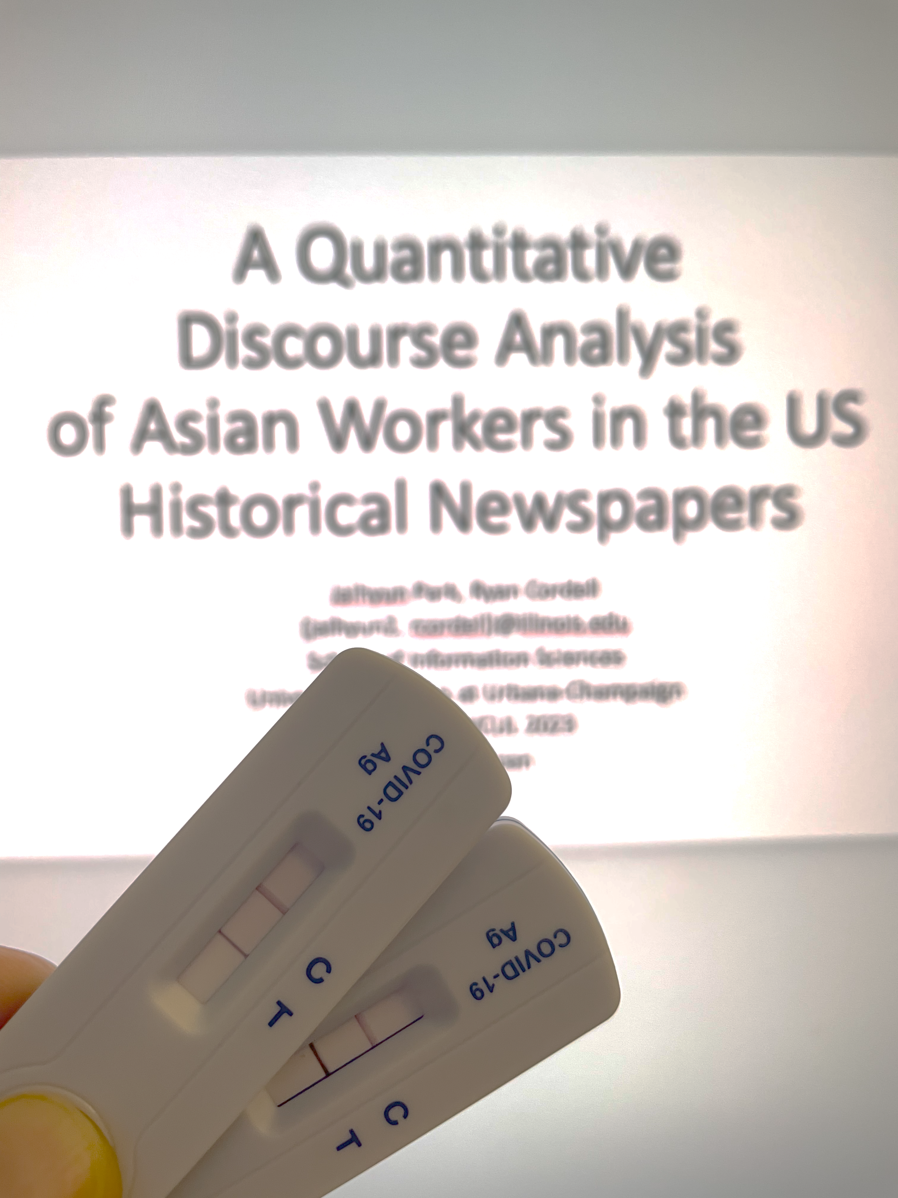
I was tested positive for COVID :(

Slide 3
Warning!: This presentation contains examples of offensive language targeting marginalized populations. Feel free to leave the room while this recording is in play when you feel uncomfortable.

Slide 4
Motivation
Digitization of historical texts has opened up new opportunities for researchers to explore a large-scale corpus with computational methods.
Taking this advantage, many researchers in diverse fields, such as Sociology, History, English, and Information Science have applied NLP techniques to historical texts such as books (Parulian et al., 2022), newspapers (Smith et al., 2013), and/or congressional records (Lin and Peng, 2022; Guldi, 2019).

Slide 5
In Digital Humanities, there have been studies primarily focused on the race problem in the US.
Soni et al. (2021) used diachronic word embedding to trace the semantic change of the word from African American newspapers corpus.
Franzosi et al. (2012) performed NER on 19C newspapers to detect locations of lynchings in Georgia.
These studies intersect the problem of historical racism and NLP research.

Slide 6
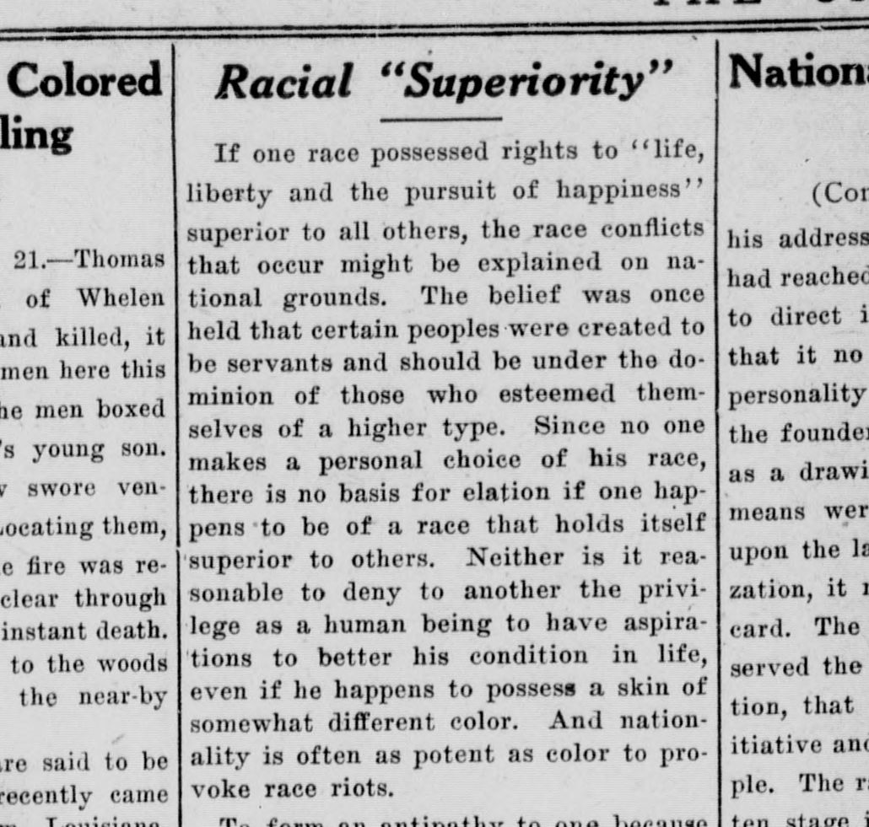
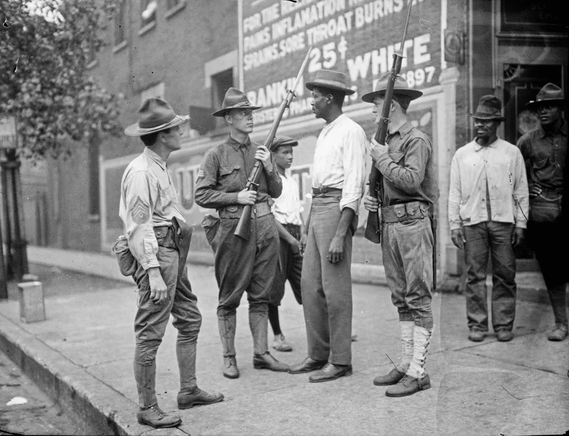
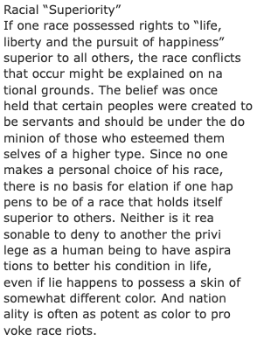
Digitized History – Image & Text
Historical Event
https://chroniclingamerica.loc.gov/lccn/sn86056950/1919-08-21/ed-1/seq-7/
Armed National Guards and African American men during the race riot in Chicago, 1919 (Red Summer)
https://chroniclingamerica.loc.gov/lccn/sn86056950/1919-08-21/ed-1/seq-7/ocr/

Slide 7
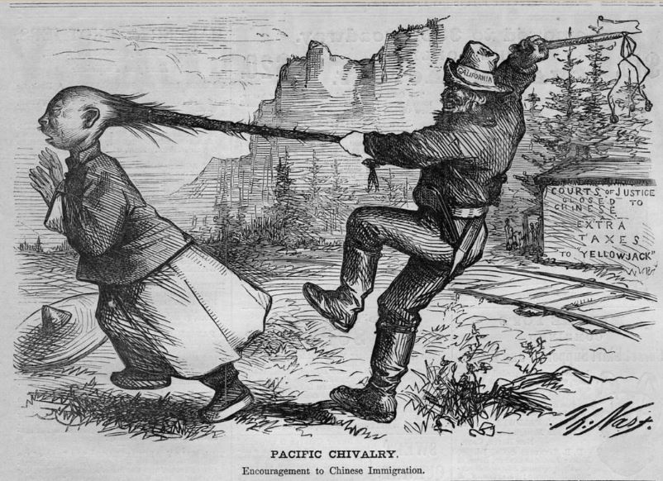
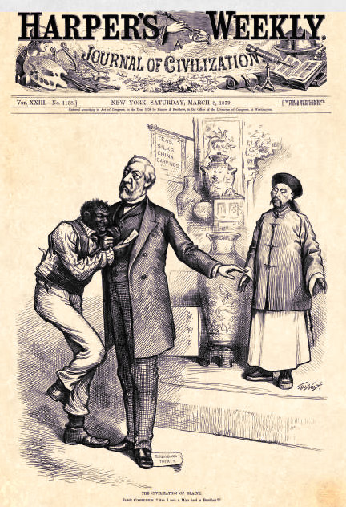
https://longislandwins.com/columns/immigrants-civil-war/ban-chinese-proposed-frederick-douglass-spoke-3/
https://thomasnastcartoons.com/2014/04/08/civilization-of-blaine-8-march-1879/
However, historical racism toward Asians in the US is understudied compared to the major race tension between White and Black.

Slide 8
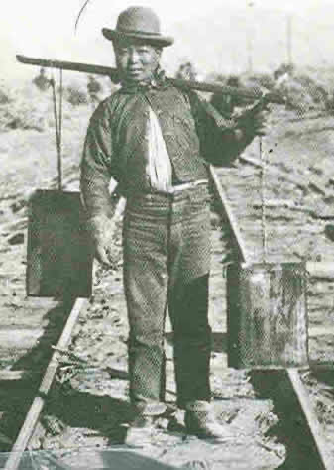
Background
Coolies: “Pejorative European usage” to describe “an unskilled labourer or porter usually in or from the Far East hired for low or subsistence wages (Britannica).
Chinese workers arrived in the US and perceived to be patient, tractable, obedient, industrious and frugal compared to African slaves (Jung, 2006)
https://www.dol.gov/general/aboutdol/hallofhonor/2014_railroad

Slide 9
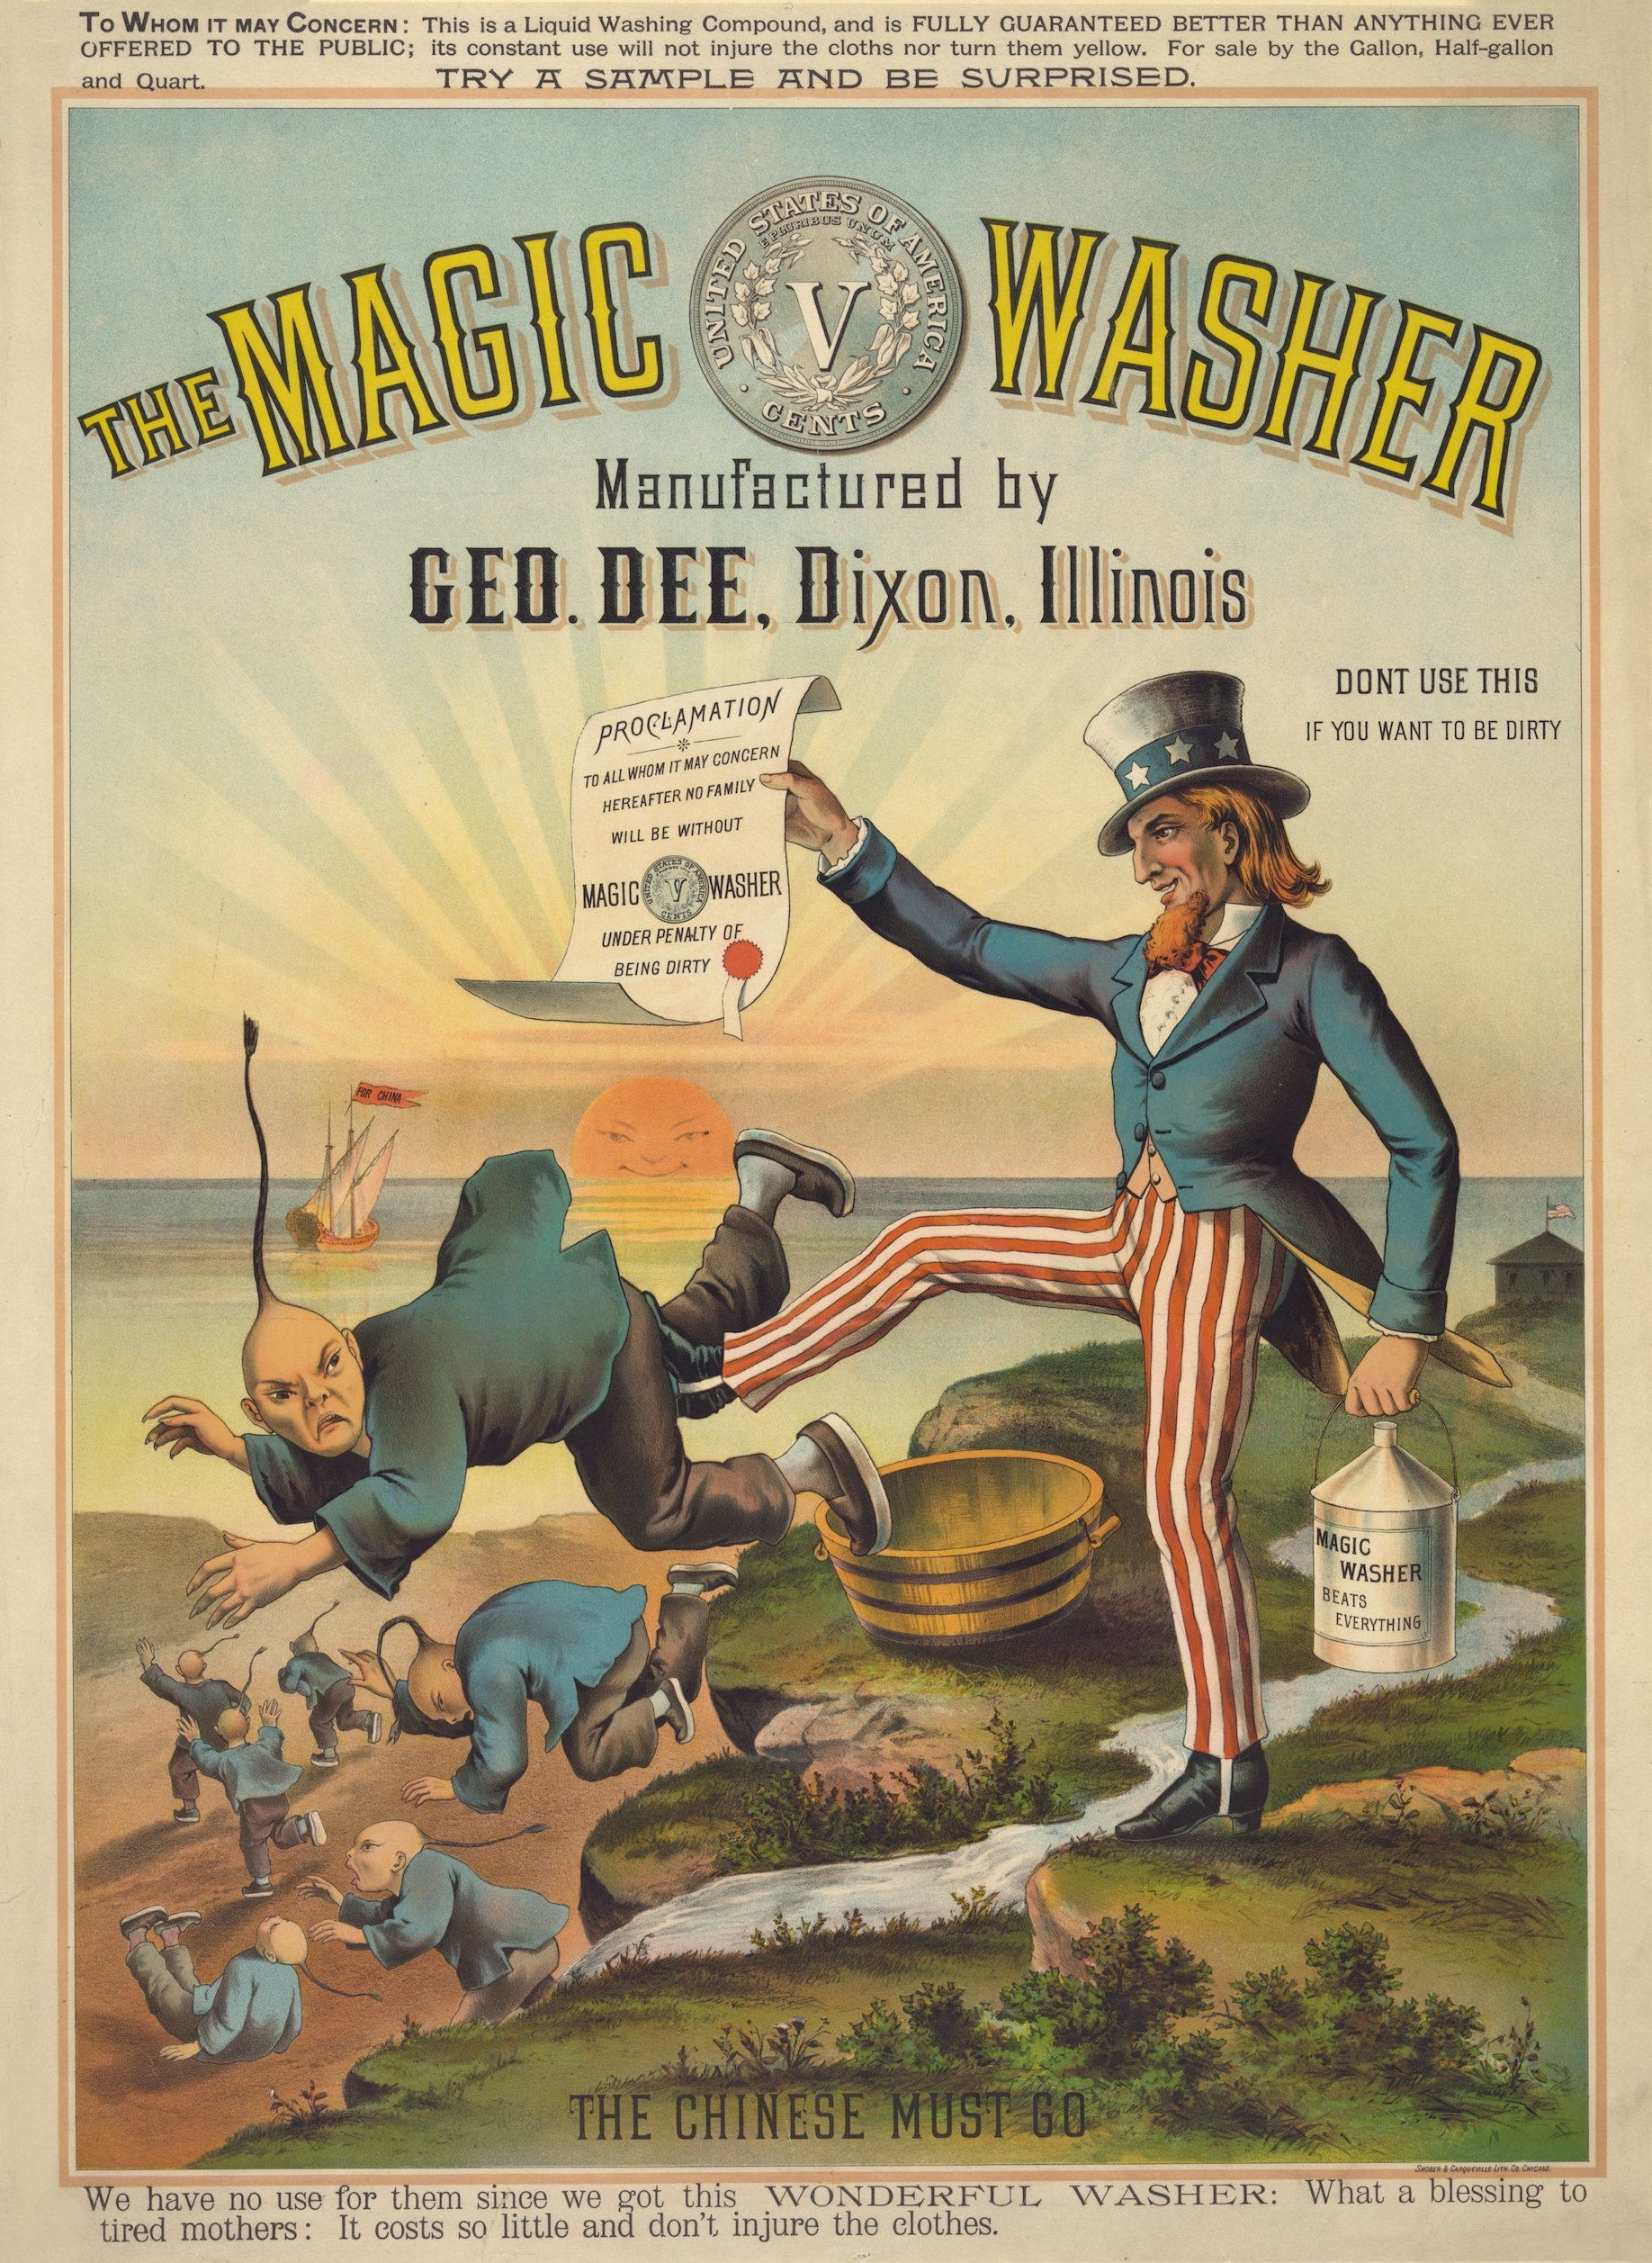
Chinese Exclusion Act of 1882: The first American gatekeeping of immigration and defined the desirability (and “Whiteness”) of immigrant groups (Lee, 2002).
The problem of coolie exemplifies the extension of colonial and capitalist exploitation beyond Africa and sugarcoated the extended system as indentured migrant contract workers (Van Rossum, 2016).
https://www.calmigration.org/exclusion

Slide 10
RQ 1. How different are the semantic meaning of “coolie” in each State?
RQ 2. What are the words over-represented in the newspapers between then-Confederate States and then-Union States?
RQ 3. What “coolie” stories are reprinted and what are their characteristics?

Slide 11
Methodology
Corpus: Chronicling America
Data collection: 124,511 newspaper pages with the search term “coolie”
Searched the exact string match for “coolie.”
Pseudo-sentence creation: ten tokens before and after where “coolie” appeared.
Data pre-processing: removed punctuations, non-alphabet tokens, stopwords (NLTK package). Lemmatiziation (Spacy).
Catch possible OCR errors: included top 200 similar tokens based on FastText embedding (Bojanowski et al., 2017) (e.g., “coolieize” (0.8654), “oroolie (0.8630), “roolie” (0.8541)).
Final data for analysis: 125,253 text

Slide 12
The count of text data is not evenly distributed due to the different digitization processes of the newspapers.
DC (n=11,302)
HI (n=8,613)
NY (n=7,671)
PR (n=15)
MA (n=305)
VI (n=656)
Figure 1: The count of text data containing the word “coolie” by State

Slide 13
RQ1. Word embedding
Word2vec model with a minimum word count of 5 and window size of 5.
To represent the State-level embedding, the embedding vector of the word “coolie” was averaged and cosine similarity was calculated across the States.

Slide 14
RQ2. Statistically over-represented words
Then-Confederate States: Alabama, Arkansas, Florida, Georgia, Louisiana, Mississippi, North Carolina, South Carolina, Tennessee, Texas, and Virginia.
Then-Union States: Maine, New York, New Hampshire, Vermont, Massachusetts, Connecticut, Rhode Island, Pennsylvania, New Jersey, Ohio, Indiana, Illinois, Kansas, Michigan, Minnesota, Wisconsin, Iowa, California, Nevada, Oregon, Delaware, Maryland, and West Virginia.
VI and PR are excluded

Slide 15
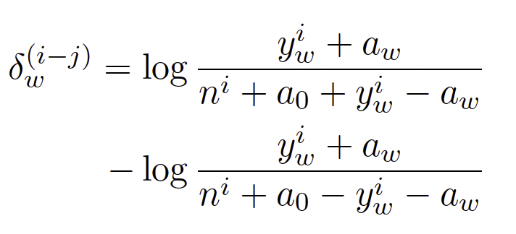
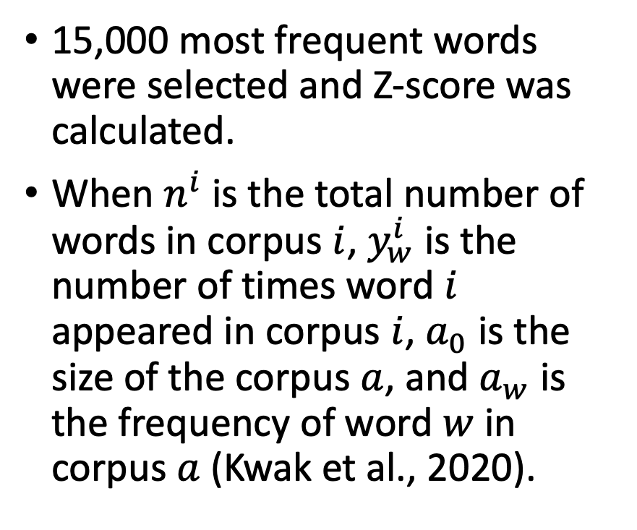
RQ2. Statistically over-represented words
15,000 most frequent words were selected and Z-score was calculated.
When $n^{i}$ is the total number of words in corpus $i$, $y_{w}^{i}$ is the number of times word $i$ appeared in corpus $i$, $a_{0}$ is the size of the corpus $a$, and $a_{w}$ is the frequency of word $w$ in corpus $a$ (Kwak et al., 2020).

Slide 16
RQ 3. Text reprint detection
We used n-gram document representations to detect text reprints within errorful OCR-derived text.
We processed the corpus with a 5-gram chunking using NLTK whitespace tokenizer and further made a judgement that the text has been reprinted when there were more than three matches of 5-grams across the corpus.
[“demolish”, “part”, “build”, “injure”, “two”, “coolie”, “police”, “investigation”, “latter”, “case”, “lead”]
[“demolish”, “part”, “build”, “jure”, ”two”, “latter”, “case”, “lead”]

Slide 17
RQ1. Results: Comparing the meaning of coolie
MA and RI showed average cosine similarity of 0.08 and 0.12 while average cosine similarity across the entire States was 0.65.
MA vs. OK (-0.10) / MA vs. ND (0.23)
RI vs. DE (-0.03) / RI vs. MS (0.23)
Some then-Confederate States showed lower cosine similarity (e.g., AR (0.43), FL (0.48), TN (0.64))
AR vs. MA (-0.06) / AR vs. CO (0.54)
FL vs. RI (0.06) / FL vs NV, UT (0.61)
TN vs. MA (-0.03) / TN vs. UT (0.80).
Figure 2:The heatmap of cosine similarity comparison across
the average embedding vector of the word “coolie” in each State.

Slide 18
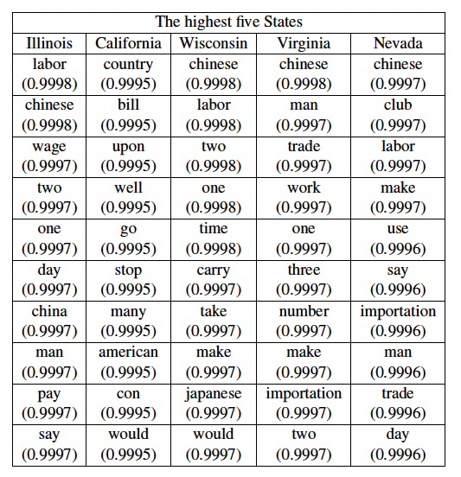
The word “coolie” was used in the context of labor, China, and wage.
Labor (e.g., “labor”, “work”): IL, WI, VA, NV.
“Chinese”: IL, WI, VA, NV / “Japanese”: WI.
Wage (e.g., “wage”, ”pay”): IL
Common words: “make”, “say”, “man”, numbers (e.g., “one”, “two”)
Table 1: Top 10 most similar words to the word “coolie” in the top 5 States
that showed the most similar meaning of the averaged word ”coolie”

Slide 19
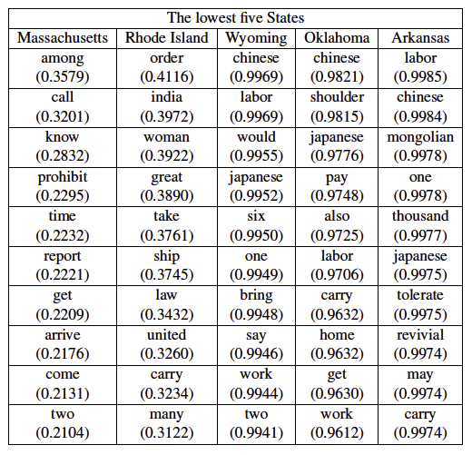
MA and RI don’t show labor, ethnicity, and wage-related words.
WY has 10 similar words in the highest top five States.
OK has unique words: “shoulder”, ”home”
AR has unique words: “Mongolian”, “tolerate”, “revival”
Table 2: Top 10 most similar words to the word “coolie” in the top 5 States
that showed the most dissimilar meaning of the averaged word ”coolie”

Slide 20
RQ 2. Results: Over-represented words
Over-represented words in then-Confederate newspapers: “trade” (-8.05), “ship” (-4.12), “slave” (-3.704), “negro” (-4.16), “nigger” (-4.88), “african” (-6.41), “plantation” (-2.02), “cotton” (-6.42)
Over-represented words in then-Union newspapers: “labor” (5.73), “wage” (4.38), “cheap” (1.22), “pay” (0.55), “rail” (1.71), “railroad” (2.31)
Figure 3: The Z-score of words in then-Confederate and then-Union newspapers

Slide 21
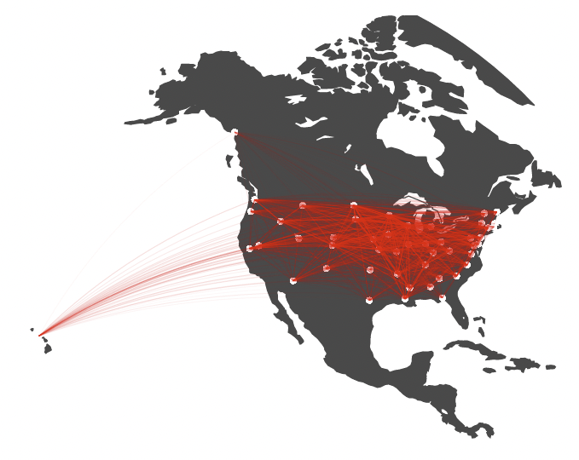
RQ 3. Results: Reprint network of coolie stories
The network of text reprints about coolie stories shows a high average clustering coefficient (0.9905) due to the presence of reprints spread to multiple States.
Figure 4: The reprint network of “coolie” stories in the newspapers

Slide 22
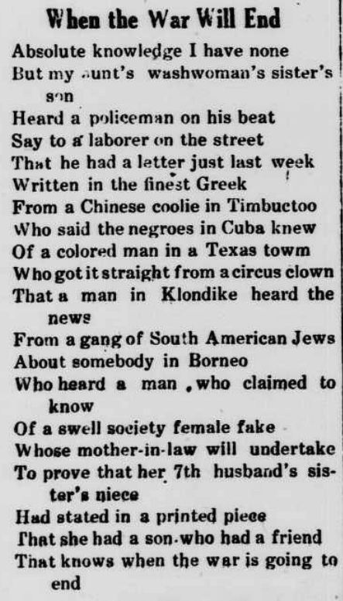
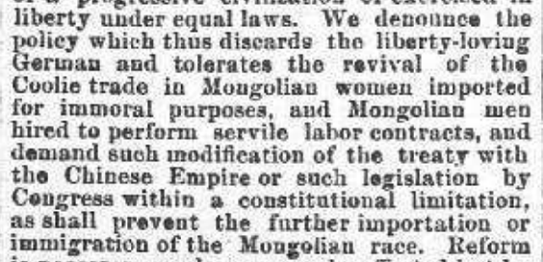
Figure 5: The text containing “coolie” in The Opelousas courier published on July 8th, 1876
The Opelousas courier (Democratic Party National Convention)
: 97 reprints
-Asians are inferior to “liberty-loving” Germans
Middletown transcript (poem)
: 78 reprints
-An emphasis on the exoticism of the places and people who are not White can
Perceive this as micro aggression as they are marginally represented in the US population.
Figure 5: The text containing “coolie” in Middletown transcript published on April 13th, 1918

Slide 23
Conclusion
MA, RI, WO, OK, and AR showed the most dissimilar meaning of the average meaning of “coolie.”
IL, CA, WI, VI, and NV showed the most similar meaning of the average meaning of “coolie.”
We found that the discourse of coolie in the then-Confederate newspapers was accompanied by words related to African American slavery as well as the workforce is the most needed.
We found discriminating expressions toward Asian workers in political statements and poems were most circulated and they showed stereotypes of Asian workers in the United States history.

Slide 24
Limitation and future work
Data-inherited limitation: (1) OCR errors, (2) a small number of digitized available data (e.g., MA (n=305) and RI (n=418) showed dissimilar meanings of the word “coolie” could have been attributed to the comparably small number of data)
Geographic representation: Grouping then-Union and then-Confederate States might not be the best way to group the States as it doesn’t reflect the Westward expansion of the US.
The impact of Chinese Exclusion Act of 1882

Slide 25
Thank you very much! The code is available!
https://github.com/park-jay/coolie
jaihyun@Illinois.edu
X (Twitter): @91jpark19

